Slide 1
FAKE PROFILE IDENTIFICATION USING RANDOM FOREST
DOMAIN : MACHINE LEARNING
SDG : GOAL 11, SUSTAINABLE CITIES AND COMMUNITIES
BATCH : A13
GUIDE: Dr. KAVITHA SUBRAMANI M.E.,PhD(PROFESSOR)
HARSHAVARDHINI A C (211420104095)
KANMANI SHREE M (211420104123)

Slide 2
ABSTRACT
At present social network sites are part of the life for most of the people.
Every day several people are creating their profiles on the social network platforms and they are interacting with others independent of the user’s location and time.
The social network sites not only providing advantages to the users and also provide security issues to the users as well their information.
To analyze, who are encouraging threats in social network we need to classify the social networks profiles of the users. From the classification,
The genuine profiles and fake profiles on the social networks. Traditionally, we have different classification method s for detecting the fake profiles on the social networks.
To improve the accuracy rate of the fake profile detection in the social networks. In this project are proposing Machine learning and Natural language Processing (NLP) techniques to improve the accuracy rate of the fake profiles detection.
The fake profile identification using techniques Support Vector Machine .

Slide 3
EXISTING PROBLEM
Even though most of the social networks have already added privacy setting features for each post, however, still any private information can be leaked.
Let’s say a post like a picture is on a user profile and user have set the e privacy for the picture to be seen just for one of user’s friends and user think it’s totally safe.
But there is no guarantee that user’s friend will not share your picture with anyone else, means that user’s friend can easily save picture and upload it somewhere or share it with someone else without any notification to user.
The users don’t care much about what they are sharing on social networks and the privacy of their post, it can be quite troublesome for them.
On top of all benefits of online social networks, there are many disadvantages identity theft is one of the biggest concerns of online social networks.

Slide 4
LITERATURE SURVEY
S.No | Journal | Author | Title | Finding | Limitation
1 | International Conference on Reliability, Infocom Technologies and Optimization (Trends and Future Directions) (ICRITO) | SurveyShruti Joshi Himanshi Gupta Nagariya | Identifying Fake Profile in Online Social Network: An Overview and Survey | Technology is associated with online social networks which has become a part in every one’s life in making new friends and keeping friends , their interests are known easier. But this increase in networking online make many problems like faking their profiles, online impersonation having become more and more in present days. | The results are about detecting the account is not fake and trained using machine learning
2. | IEEE,Conference,Journal | P.L., Traskin, M | Fake Profile Identification using Machine Learning | Propose a model that could be used to classify an account as fake or genuine. This model uses Support Vector Machine as a classification technique and can process a large dataset of accounts at once, eliminating the need to evaluate each account manually. The community of concern to us here is Fake Accounts and our problem can be said to be a classification or a clustering problem. | SVM is able to classify between fake and genuine profiles with a reasonable degree of accuracy (<50%).

Slide 5
LITERATURE SURVEY
S.No | Journal | Author | Title | Finding | Limitation
3 | International Journal of Recent Technology and Engineering ) | K.SivaNandini, P.Bhavya Anjali, K. Devi | Identifying Fake Profile in Online Social Network: An Overview and Survey | Technology is associated with online social networks which has become a part in everyone's life in making new friends and keeping friends , their interests are known easier. But this increase in networking online make many problems like faking their profiles, online impersonation having become more and more in present days. | The results are about detecting the account is not fake and trained using machine learning
4 | Webaccess,scope ,IEEE Conference | Sarah Khaled Hoda M. O. Mokhtar Neamat | Detecting Fake Accounts on Social Media | online social networks(OSNs) have become increasingly popular, people’s social lives had become more associated with these sites. They use OSNs to keep in touch with each others, share news, organize events,and even run their own e-business. | classification algorithm was proposed to improve detecting fake accounts on social networks not accuracy

Slide 6
LITERATURE SURVEY
S.No | Journal | Author | Title | Finding | Limitation
5 | International Conference on Reliability, IJCRT | SurveyShruti Joshi Himanshi Gupta Nagariya | Prediction of Fake Profiles | Facebook is a social networking site. This site has changed the way people pursue social life and made it easy to connect with family members, classmates, friends and colleagues. Based on the data available for the first quarter of 2016 facebook has approximately 1.65 billion active users | The proposed model has used machine learning algorithms like support vector machine, Decision Tree(DT), artificial neural networks(ANN) and Naive Bayes (NB) to classify the user profiles into fake and genuine.

Slide 7
PROBLEM STATEMENT
Identifying fake profiles in social networks presents a significant challenge due to the evolving tactics employed by malicious actors. These fake profiles can be used for various malicious purposes, including spreading is information, conducting fraudulent activities, or manipulating public opinion. Traditional methods of detection, such as analyzing account activity and engagement patterns, often fall short in identifying sophisticated fake profiles that mimic genuine user behavior. Moreover, the sheer volume of users on popular social platforms makes manual identification impractical. As a result, there is a pressing need for innovative approaches that leverage advanced technologies like machine learning and natural language processing to detect CNN algorithm was used in existing system of fake profile identification system.
Online Social Networks (OSN) are popular applications for sharing various data, including text, photos, and videos.
A novel pooling layer to optimize the neural network poor performance in the training process.
Demonstrated by the experiments result with better accuracy and small loss than common learning algorithms in a malicious account classification task.

Slide 8
OBJECTIVE
Fake profiles are a pervasive issue on social networking platforms, posing various risks and challenges for users. Identification of fake profiles is crucial in maintaining the integrity and security of online communities. These deceptive accounts are typically created with false or misleading information, often with the intention of spreading misinformation, engaging in fraudulent activities, or harvesting personal data. Common characteristics of fake profiles include unrealistic profile pictures, minimal personal information, inconsistent details, and a high volume of friend requests or connections. To detect fake profiles, social network user and platforms can utilize various techniques such as reverse image search, analyzing posting patterns, checking account creation dates, and monitoring for suspicious behavior like excessive messaging or spamming. By actively identifying and reporting fake profiles, users can help minimize the spread of misinformation and protect themselves and others from potential online threats.

Slide 9
IMPLEMENTATION ENVIRONMENT
Framework: Keras.
Software Requirements:
Operating System : Windows/Linux
Simulation Tool : Jupyter Notebook
Language : Python
Hardware requirements:
Processor : Pentium Dual Core 2.00GHZ
Hard disk : 120 GB
RAM : 2GB (minimum)
Keyboard : 110keys enhanced

Slide 10
PROPOSED METHODOLOGY
The Application Domain of the following project was profile Detection using Random Forest technique.
Profile detection is key to understanding the structure of complex networks, and ultimately extracting useful information from them.
In this project, we came up with a framework through which we can detect a fake profile using machine learning algorithms so that the social life of people become secured.

Slide 11
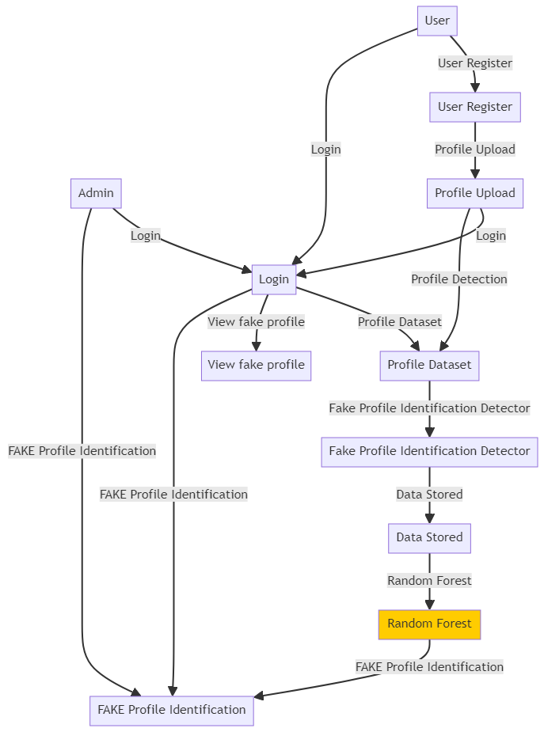
SYSTEM ARCHITECTURE
This displays the whole design of our working model including the components and the states occurring during the execution of the process. It displays the very initial process of image feeding followed by pre-processing. The System process the input and thus provide output predicted by the model.

Slide 12
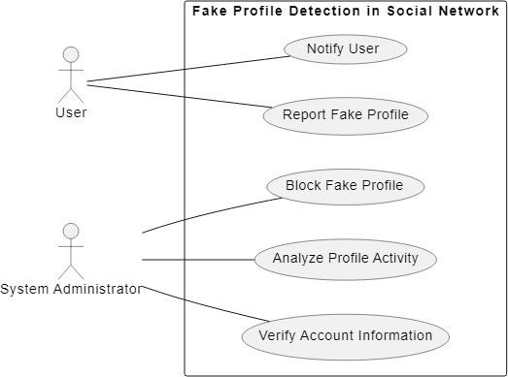
UML DIAGRAM
USECASE DIAGRAM:

Slide 13
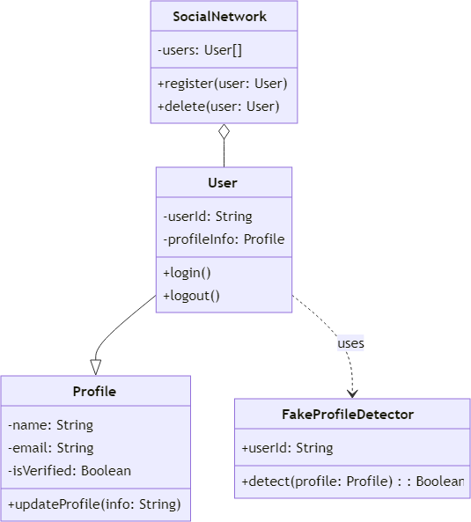
CLASS DIAGRAM:

Slide 14
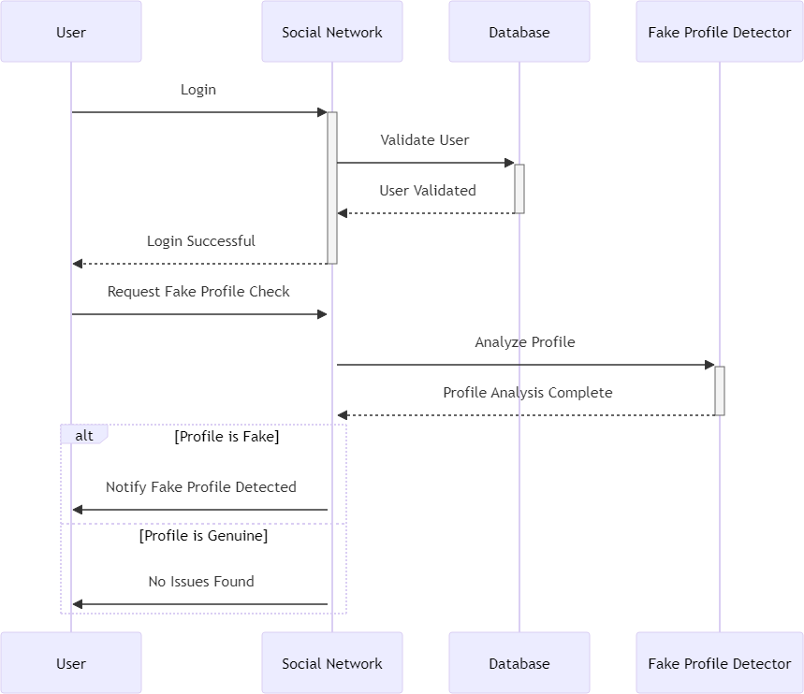
SEQUENCE DIAGRAM:

Slide 15
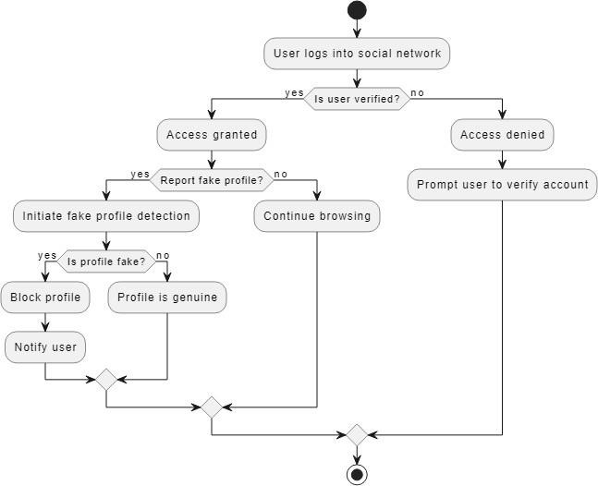
ACTIVITY DIAGRAM:

Slide 16
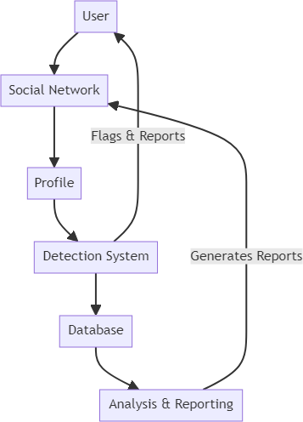
COLLABORATION DIAGRAM:

Slide 17
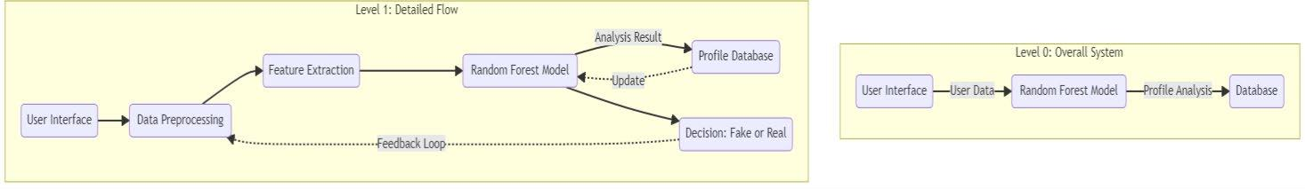
DATAFLOW DIAGRAM:

Slide 18
MODULE DESIGN
Data Preprocessing Module
Random Forest Classifier Module
Feature Importance Analysis Module
Model Deployment Module
User Interface Module
Model Maintenance and Updates Module

Slide 19
MODULE DESCRIPTION
Data Preprocessing Module:
Data Cleaning: Remove missing values, duplicates, and irrelevant features.
Feature Engineering: Extract relevant features such as profile creation date, activity frequency, friend count, etc.
Data Transformation: Convert categorical variables into numerical form using techniques like one-hot encoding or label encoding.
Data Splitting: Divide the dataset into training and testing sets for model evaluation.
Random Forest Classifier Module:
Random Forest Model Initialization: Initialize a Random Forest classifier with default or customized parameters.
Model Training: Train the Random Forest classifier on the training dataset to learn patterns indicative of fake profiles.
Model Evaluation: Evaluate the performance of the trained model using metrics such as accuracy, precision, recall, F1-score, and ROC-AUC score.
Hyperparameter Tuning: Fine-tune the hyperparameters of the Random Forest classifier using techniques like grid search or random search to improve model performance.

Slide 20
MODULE DESCRIPTION
Feature Importance Analysis Module:
Importance Calculation: Analyze the importance of each feature in the Random Forest model in distinguishing between fake and genuine profiles.
Visualization: Visualize feature importances using techniques like bar plots or heatmaps to understand which features contribute most to the classification.
Model Deployment Module:
Integration: Integrate the trained Random Forest classifier into a web application or API for real-time or batch processing.
Deployment: Deploy the model on a suitable platform such as cloud services (e.g., AWS, Azure) or on-premises servers.
Monitoring: Implement monitoring mechanisms to track the performance of the deployed model and detect drifts in data distribution.

Slide 21
MODULE DESCRIPTION
User Interface Module :
Development: Design and develop a user-friendly interface for users to interact with the fake profile identification system.
Input Processing: Accept user input (profile data) and preprocess it before feeding it into the Random Forest classifier.
Output Presentation: Display the classification result (fake or genuine profile) along with confidence scores or probability estimates.
Model Maintenance and Updates Module:
Monitoring: Monitor model performance over time and retrain the model periodically using updated data to ensure its effectiveness.
Version Control: Implement version control to track changes made to the model, its dependencies, and the dataset.
Documentation: Maintain comprehensive documentation covering model updates, performance metrics, and deployment procedures for future reference.

Slide 22
MODULE DESCRIPTION
Fake Profile detection:
On one hand, these social networks provide the advantage of direct connectivity between people, information sharing, ways to create a large audience, etc. on the other hand people also misuse them in many ways. Social networking sites are suffering from people who own bulk of fake accounts to take advantage of vulnerabilities for their immoral benefits. These actions motivate researchers to develop a system that can detect fake accounts on these OSNs.

Slide 23
RESULTS
To evaluate the effectiveness of the fake profile detection system, several performance metrics will be considered. These metrics will assess the system's ability to accurately identify fraudulent accounts, predict suspicious behavior, and provide actionable insights to social media platforms and law enforcement agencies. The following performance metrics will be analyzed.
Accuracy: The percentage of correctly identified fake profiles compared to the total number of profiles analyzed. This metric measures the overall effectiveness of the system in detecting fraudulent accounts.

Slide 24
RESULT
Precision and Recall: Precision measures the proportion of correctly identified fake profiles among all profiles flagged as fake by the system, while recall measures the proportion of correctly identified fake profiles among all actual fake profiles. These metrics provide insights into the system's ability to minimize false positives (precision) and false negatives (recall).
F1 Score: The harmonic mean of precision and recall, providing a balanced measure of the system's performance in identifying fake profiles. A higher F1score indicates better overall performance in terms of both precision and recall.

Slide 25
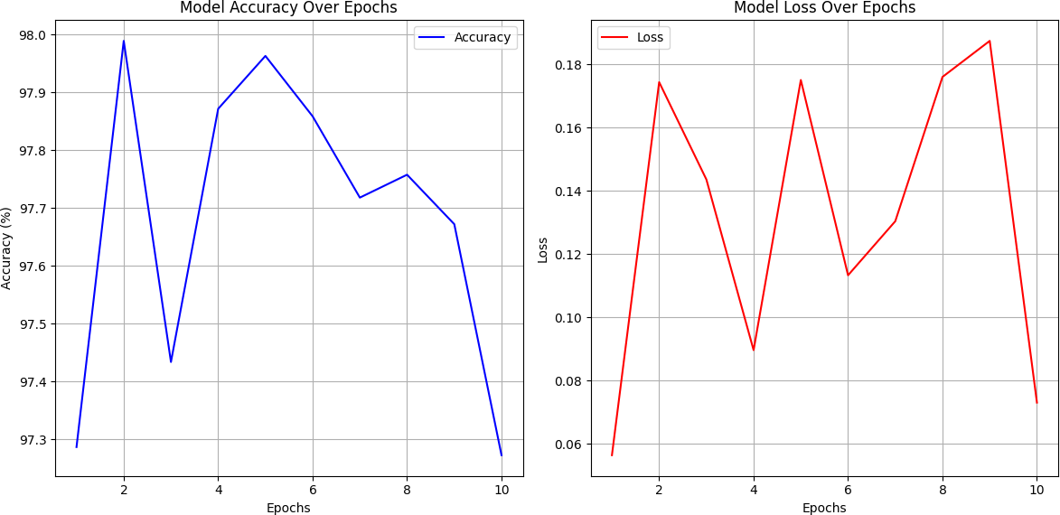
GRAPH

Slide 26
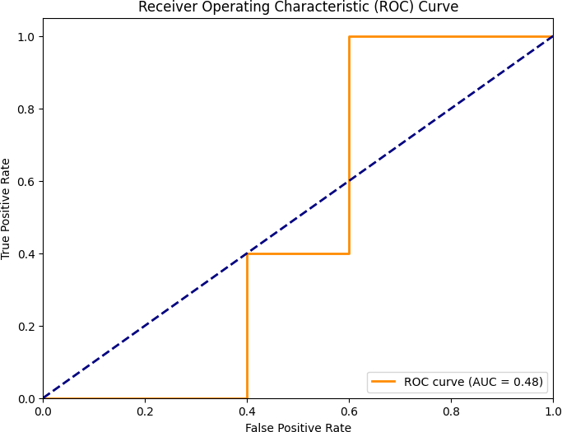
GRAPH

Slide 27
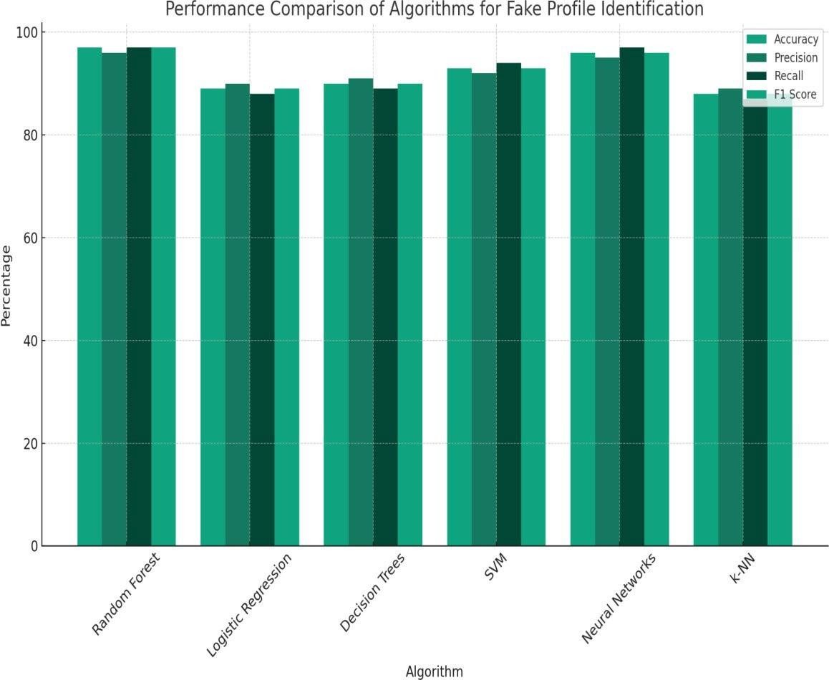
GRAPH

Slide 28

OUTPUT SCREENSHOT

Slide 29
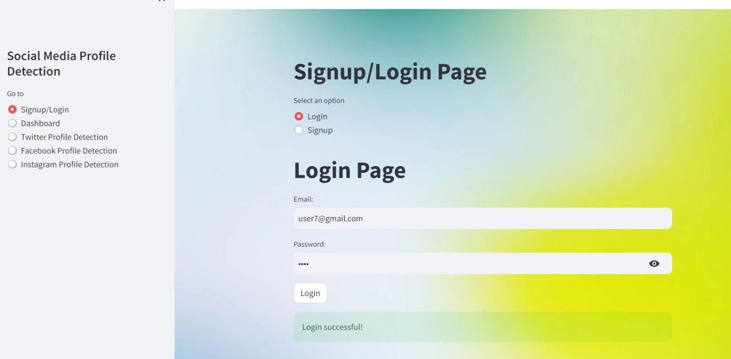

Slide 30
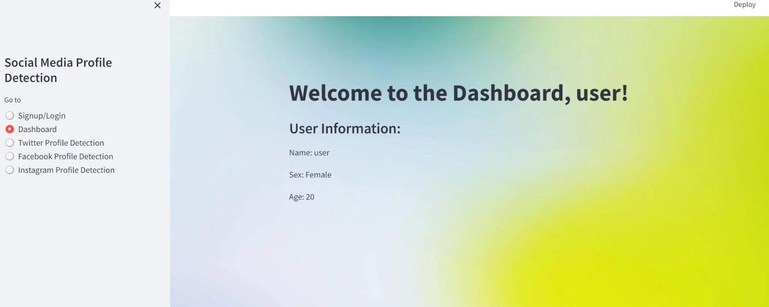

Slide 31
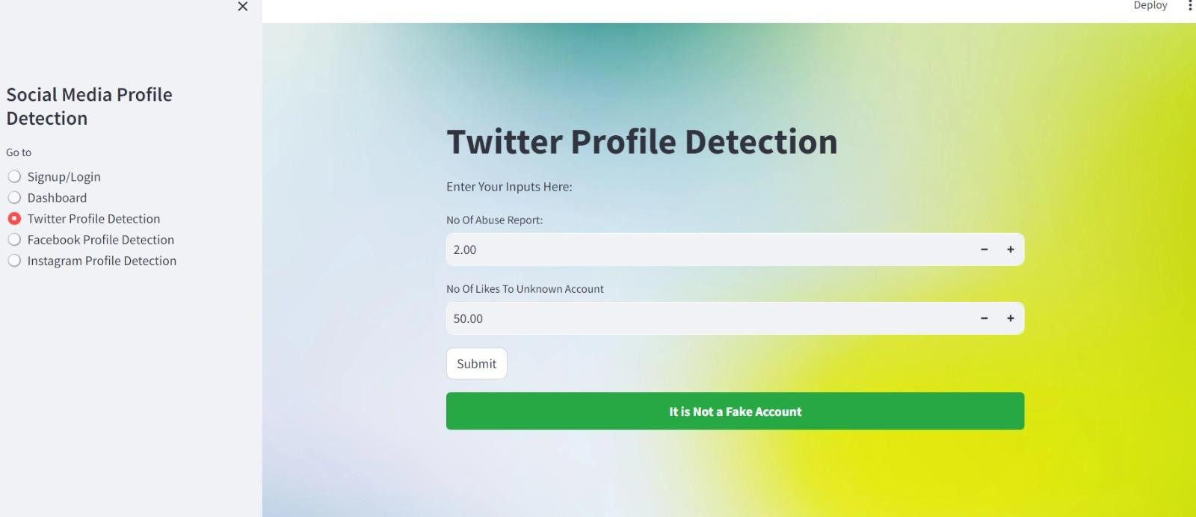

Slide 33
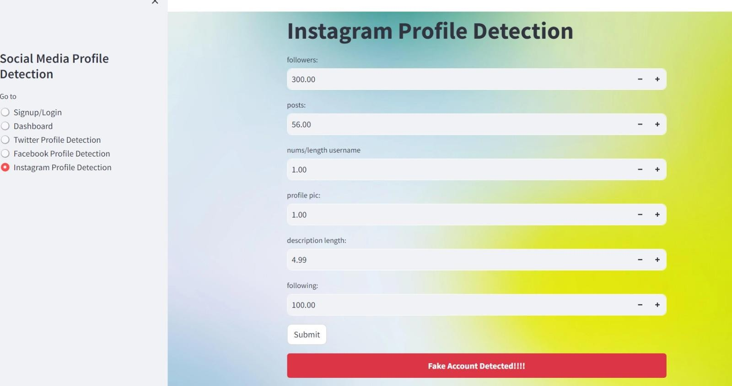

Slide 34
REFERENCES
Yang, S., Shu, K., Wang, S., Gu, R., Wu, F., & Liu, H. (2019). "Unsupervised fake news detectiononsocialmedia:Agenerativeapproach."InProceedingsoftheAAAIconference on artificial intelligence (Vol. 33, No. 01, pp. 5644-5651).
Monti, F., Frasca, F., Eynard, D., Mannion, D., & Bronstein, M. M. (2019). "Fake news detectiononsocialmediausinggeometricdeeplearning."arXivpreprintarXiv:1902.06673.
Pulido,C.M.,Ruiz-Eugenio,L.,Redondo-Sama,G.,&Villarejo-Carballido,B.(2020)."A new application of social impact in social media for overcoming fake news in health." International journal of environmental research and public health, 17(7), 2430.
Zhou,X.,&Zafarani,R.(2019)."Network-basedfakenewsdetection:Apattern-driven approach." ACM SIGKDD explorations newsletter, 21(2), 48-60.
Shu, K., Bernard, H. R., & Liu, H. (2019). "Studying fake news via network analysis: detectionandmitigation."Emergingresearchchallengesandopportunitiesincomputational social network analysis and mining, 43-65.
Benabbou, F., Boukhouima, H., &Sael, N.(2022). "Fake accounts detectionsystembased onbidirectionalgatedrecurrentunitneuralnetwork."InternationalJournalofElectricaland Computer Engineering (IJECE), 12(3), 3129.
Shu,K.,Zhou,X.,Wang,S.,Zafarani,R.,&Liu,H.(2019). "Theroleofuserprofiles for fake news detection."InProceedings ofthe 2019IEEE/ACM internationalconferenceon advances in social networks analysis and mining (pp. 436-439).

Slide 35
REFERENCES
X., & Ghorbani, A. A. (2020). An overview of online fake news: Characterization,detection,anddiscussion. InformationProcessing&Management, 57(2), 102025.
Talwar,S.,Dhir, A.,Singh,D.,Virk,G.S.,&Salo,J.(2020).Sharingoffakenews on social media: Application of the honeycomb framework and the third-person effect hypothesis. Zhang Journal of Retailing and Consumer Services, 57, 102197.
Carlson,M.(2020). Fakenewsasaninformationalmoralpanic:Thesymbolic deviancy of social media during the 2016 US presidential election. Information, Communication & Society, 23(3), 374-388.
Islam,M.R.,Liu,S.,Wang,X.,&Xu,G.(2020). Deeplearningformisinformation detection on online social networks: a survey and new perspectives. Social Network Analysis and Mining, 10(1), 82.
DiDomenico,G.,Sit,J.,Ishizaka,A.,&Nunan,D.(2021).Fakenews,socialmedia and marketing: A systematic review. Journal of Business Research, 124, 329-341. [16]Himelein-Wachowiak,M.,Giorgi,S.,Devoto,A.,Rahman,M.,Ungar,L.,Schwartz,
H. A., ... &Curtis, B. (2021). Bots and misinformationspread onsocial media: Implications for COVID-19. Journal of medical Internet research, 23(5), e26933.
.

Slide 36
Thank you !

